Slide 1
Telecom Customer Churn Prediction
End-to-End Machine Learning Pipeline

Slide 2
Agenda

Slide 3
Problem Statement & Objective
The Business Problem
Acquiring a new customer costs 5–7× more than retaining an existing one
High churn directly impacts revenue, profitability, and sustainability
Reactive strategies (post-churn discounts) are far costlier than proactive ones
What We Built
A binary classification model that predicts churn before it happens, enabling targeted retention campaigns.
Priority | Metric | Why
1st | Recall | Missing a churner = lost revenue
2nd | ROC-AUC | Discriminative power across thresholds
3rd | F1 Score | Balance of precision & recall

Slide 4
Dataset Overview
Records: 7,043 customers | Features: 21 columns | Target: Churn (Yes/No)
Class Split: No Churn = 5,174 (73.5%) | Churn = 1,869 (26.5%) ⚠️ Imbalanced
Category | Features
Demographics | gender, SeniorCitizen, Partner, Dependents
Services | PhoneService, MultipleLines, InternetService, OnlineSecurity, OnlineBackup, DeviceProtection, TechSupport, StreamingTV, StreamingMovies
Contract & Billing | Contract, PaperlessBilling, PaymentMethod
Numeric | tenure, MonthlyCharges, TotalCharges

Slide 5
Data Cleaning
Issues Found and Fixed
Issue | Action Taken
TotalCharges stored as object | Converted to float64 via pd.to_numeric()
11 NaN values in TotalCharges | Set to 0 where tenure = 0 (new customers, never billed)
Duplicate rows | 0 duplicates found
Outliers (IQR + Boxplot + Scatter) | No actionable outliers — extreme values are valid
customerID column | Dropped — identifier, not a feature
Imputation logic: All 11 nulls had tenure = 0 → TotalCharges = $0 is the only business-correct choice. Median imputation would break the tenure–billing relationship.

Slide 6
Exploratory Data Analysis
Numerical Insights
Top Categorical Churn Drivers
Feature | Churned Customers | Retained Customers | Insight
Avg Tenure | 17.9 months | 37.6 months | Short tenure = high risk
Avg MonthlyCharges | $74.44 | $61.27 | Higher bills drive churn
Avg TotalCharges | $1,531 | $2,549 | Churners leave before accumulatin
Feature | High-Risk Group | Churn Rate
Contract | Month-to-month | 42.7%
PaymentMethod | Electronic check | 45.3%
InternetService | Fiber optic | Highest among all types
OnlineSecurity | Not subscribed | 41.8%
TechSupport | Not subscribed | 41.6%
High-Risk Profile (Identified via EDA)
Month-to-month + Fiber optic + tenure < 12 months + no OnlineSecurity/TechSupport → 73.5% churn rate

Slide 7
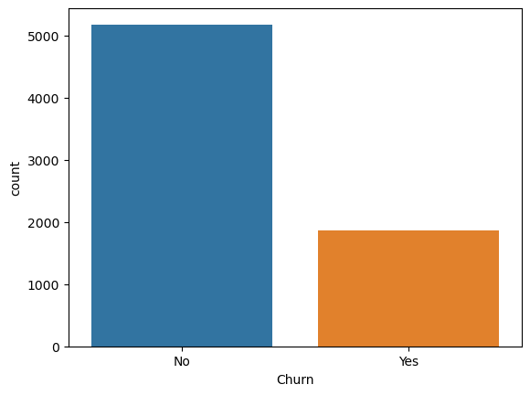
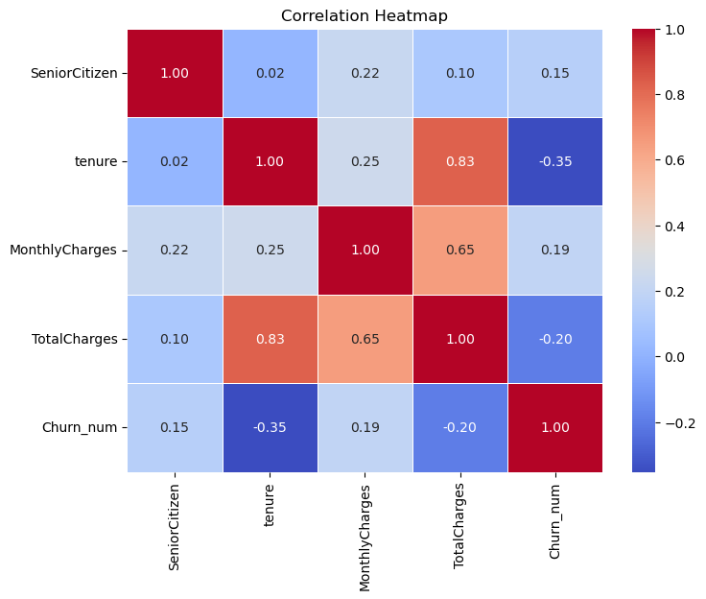

Slide 8
Feature Engineering
21 Original Features → 60 Engineered Features
Group | Key Features Created
Tenure-Based | TenureGroup, IsFirstYear, IsVeryNew, IsLongTerm, IsContractEnd
Monetary | AvgMonthlyCharge, CustomerLTV, MonthlytoTotalRatio, MonthlyChargeGroup
Service Usage | NumAdditionalServices, HasSecurityBundle, HasStreamingBundle, FiberOpticUser, ServicesPerMonth
Contract & Payment | ContractType, IsMonthToMonth, PaymentRisk, ElectronicPayment, PaperlessHighRisk
Risk & Interaction | HighCostLowTenure, MonthToMonth_Fiber, EngagementScore, SimpleRiskScore

Slide 9
ML Pipeline Architecture

Slide 10
Encoding, Scaling & Feature Selection
Encoding
pd.get_dummies(drop_first=True) — One-Hot Encoding → 51 features
Train/test alignment with fill_value=0 to prevent column mismatch
Scaling
StandardScaler — fit only on X_train, transform applied to X_test
Prevents data leakage; required for Logistic Regression
Feature Selection — L1 Lasso
LogisticRegression(penalty='l1', C=0.1, solver='liblinear')
L1 drives irrelevant feature coefficients to exactly zero
Result: 32 features selected, 19 eliminated
Top selected features: contract type, tenure, monthly charges, electronic payment, fiber optic, engagement score

Slide 11
Class Imbalance — SMOTE
Problem
Train set: 4,139 No Churn vs 1,495 Churn (2.77:1 ratio)
Models biased toward predicting majority class → poor recall on churners
Solution: SMOTE (Synthetic Minority Oversampling)
Generates synthetic minority samples by interpolating between real ones
Applied only on training data — never on test set (no leakage)
Result
Class | Before SMOTE | After SMOTE
No Churn | 4,139 | 4,139
Churn | 1,495 | 4,139
Total | 5,634 | 8,278

Slide 12
Model Training — 5-Fold Cross-Validation
Strategy: StratifiedKFold (n=5, shuffle=True) on SMOTE-balanced data
4 Models evaluated: Logistic Regression, Decision Tree, Random Forest, XGBoost

Slide 13
Hyperparameter Tuning — RandomizedSearchCV
Why Randomized? Samples n_iter combinations from distributions — faster than GridSearch with near-equal results
Scoring: roc_auc | CV: 5-fold stratified
Model | Best Parameters | CV AUC
Logistic Regression | C=0.599, penalty=l1, solver=liblinear | 0.8484
Decision Tree | criterion=entropy, max_depth=15, min_samples_leaf=9 | 0.8821
Random Forest | n_estimators=330, max_depth=20, max_features=sqrt | 0.9188
XGBoost | n_estimators=274, max_depth=8, lr=0.12, subsample=0.993

Slide 14
Model Comparison — Test Set Results
🏆 Logistic Regression wins — highest ROC-AUC (0.8392) and highest Recall (0.7968)

Slide 15
Why Logistic Regression Won
XGBoost had the best CV AUC (0.9335) — so why did
LR win on test data?
Model Verdict Summary
Reason | Explanation
Recall is critical | LR Recall = 0.797 vs XGBoost = 0.612 — LR catches far more churners
SMOTE distribution shift | XGBoost overfits to synthetic samples; LR's linear boundary generalizes better
ROC-AUC on real data | LR 0.839 > XGBoost 0.832 — LR is a better rank-ordering model here
Feature selection alignment | L1 selection was designed for LR's assumptions — features fit LR naturally
Model | Verdict
Logistic Regression | ✅ Best recall + AUC on real data
XGBoost | ⚠️ Overfit to SMOTE distribution
Random Forest | ⚠️ Lower recall — misses too many churners
Decision Tree | ❌ Weakest overall

Slide 16
Threshold Tuning & Business Cost
Business Cost Model
FP Cost = $100 (retention offer sent to non-churner)
FN Cost = $500 (missed churner = lost customer)
Total Cost = FP × $100 + FN × $500

Slide 17
SHAP Interpretability
Why SHAP?
Quantifies each feature's contribution to every individual prediction
Based on game theory — guarantees fair, consistent attribution
Makes the model explainable to both technical and business stakeholders
Top SHAP Features & Their Impact
Feature | Direction | Insight
ContractType (low) | ↑ Churn risk | Month-to-month = #1 churn driver
tenure (low) | ↑ Churn risk | New customers = highest vulnerability
MonthlyCharges (high) | ↑ Churn risk | High bills push customers to leave
ElectronicPayment | ↑ Churn risk | Strongest payment risk signal
FiberOpticUser | ↑ Churn risk | Premium price without perceived value

Slide 18
Final Results & Key Takeaways

Slide 19
Final Results & Key Takeaways
Top Retention Recommendations
Risk Signal | Recommended Action
Month-to-month + New + Fiber | Priority outreach in first 3 months
Electronic check payment | Migrate to auto-pay with discount
No add-on services | Bundle offer: security + tech support
MonthlyCharges > $70 + short tenure | Loyalty discount or plan downgrade
Saved Artifacts
best_churn_model.pkl · scaler.pkl · selected_features.pkl · optimal_threshold.pkl
"The goal isn't just to predict who will churn — it's to predict it early enough to act."
Python · Scikit-learn · XGBoost · SMOTE · SHAP · Pandas · Seaborn

Slide 20


